Slide 1
BITS Pilani presentation
K. Venkata Ratnam
Mathematics

Slide 2
Course Number : SS ZC416
Course Title: MATHEMATICAL FOUNDATIONS
FOR DATA SCIENCE
Lecture No. :4

Slide 3
Vector space example

Slide 4
Cont..

Slide 5
Cont..

Slide 6
Not a vector space
( at least one property has to fail)
The set of all integers is not a vector space
Pf:
(it is not closed under scalar multiplication)
scalar
noninteger
integer

Slide 7
.
Example subspace
Give an example of a subspace of the vector space of polynomials in x with real coefficients of degree at most 2 .
Let P₂ denote the vector space of polynomials in x with real coefficients of degree at most 2.
Consider W={ax²+bx+c; a,b,c∈R}
Let u= ax²+bx+c and v= a’x²+b’x+c’ where a, a′,b,b’,c,c’∈R. Then u, v∈W. Also, u+v=(a+a′)x² +(b+b’)x+(c+c’)∈W.
If λ∈R, then λu=(λa)x² +(λb)x+(λc) ∈W.
Thus, W is a subspace of P₂.

Slide 8
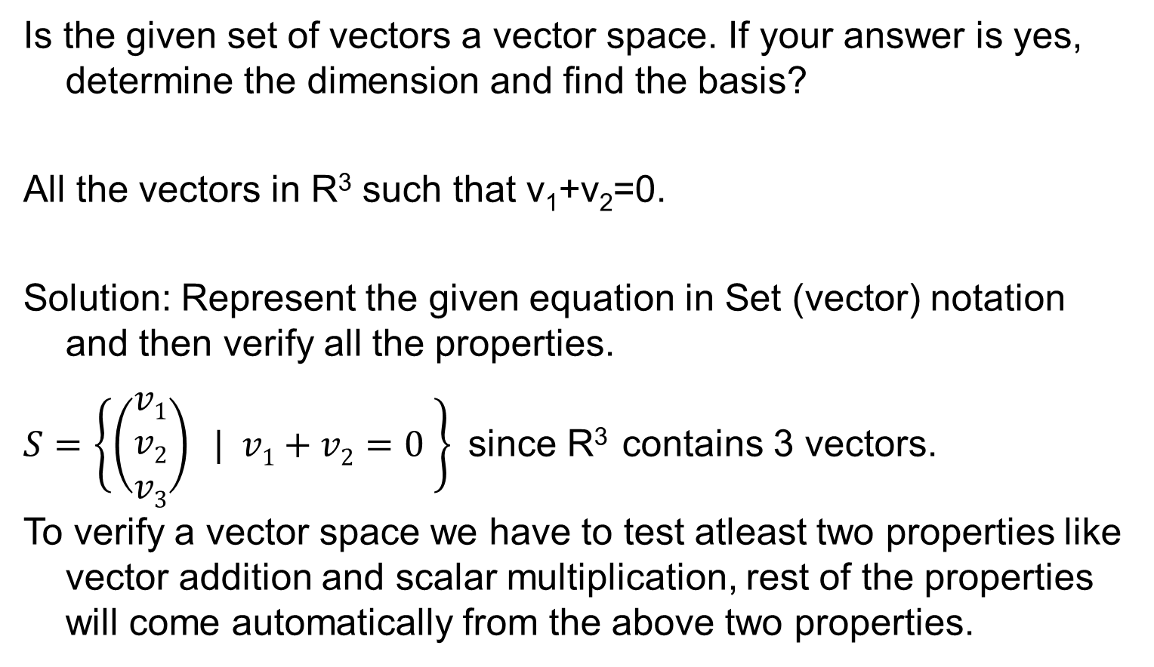
Vector space
Is the given set of vectors a vector space. If your answer is yes, determine the dimension and find the basis?
All the vectors in R³ such that v₁+v₂=0.
Solution: Represent the given equation in Set (vector) notation and then verify all the properties.
$S=\left\{\left(\begin{matrix}v1 \\ v2 \\ v3\end{matrix}\right) | v1+v2=0 \right\}$since R³ contains 3 vectors.
To verify a vector space we have to test atleast two properties like vector addition and scalar multiplication, rest of the properties will come automatically from the above two properties.

Slide 9
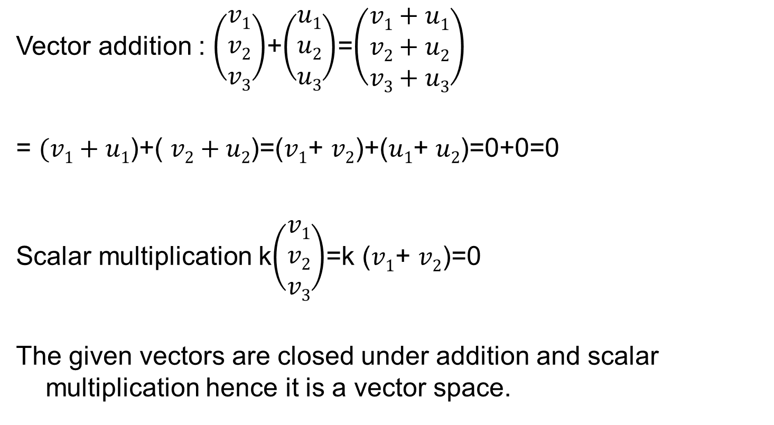
Vector space
Vector addition : $\left(\begin{matrix}v1 \\ v2 \\ v3\end{matrix}\right)$+$\left(\begin{matrix}u1 \\ u2 \\ u3\end{matrix}\right)$=$\left(\begin{matrix}v1+u1 \\ v2+u2 \\ v3+u3\end{matrix}\right)$
= $(v1+u1$)+( $v2+u2$)=($v1$+ $v2$)+($u1$+ $u2$)=0+0=0
Scalar multiplication k$\left(\begin{matrix}v1 \\ v2 \\ v3\end{matrix}\right)$=k ($v1$+ $v2$)=0
The given vectors are closed under addition and scalar multiplication hence it is a vector space.

Slide 10
Vector space
Basis : v₁+v₂=0 for the given condition v₃ is arbitrary;
So v₁ = -v_{2;}
v₂ = s
v₃ = t v₁ = - s, v₂ =s, v₃ = t ; (-s, s, t)= s(-1,1,0)+t(0,0,1)
Basis is (-1,1,0) (0,0,1); since these two vector are independent and any vector in this space can be expressed as a linear combination of (-1,1,0) (0,0,1);
Dimension : 2

Slide 11
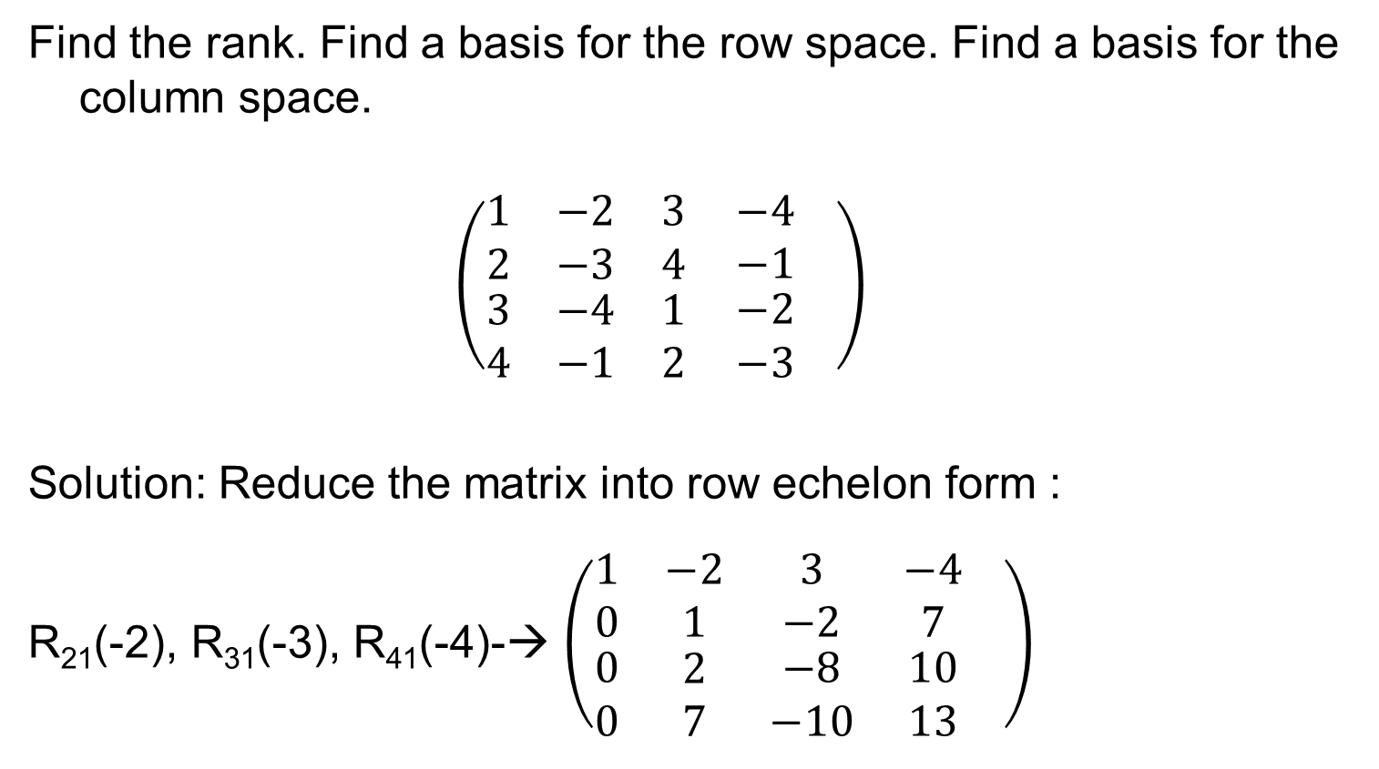
Examples: Rank, basis of row space
Find the rank. Find a basis for the row space. Find a basis for the column space.
$$\left(\begin{matrix}1 & −2 & 3 \\ 2 & −3 & 4 \\ \begin{aligned}3 \\ 4\end{aligned} & \begin{aligned}−4 \\ −1\end{aligned} & \begin{aligned}1 \\ 2\end{aligned}\end{matrix} \begin{matrix}−4 \\ −1 \\ \begin{aligned}−2 \\ −3\end{aligned}\end{matrix} \right)$$
Solution: Reduce the matrix into row echelon form :
R₂₁(-2), R₃₁(-3), R₄₁(-4)-→ $\left(\begin{matrix}1 & −2 & 3 \\ 0 & 1 & −2 \\ \begin{aligned}0 \\ 0\end{aligned} & \begin{aligned}2 \\ 7\end{aligned} & \begin{aligned}−8 \\ −10\end{aligned}\end{matrix} \begin{matrix}−4 \\ 7 \\ \begin{aligned}10 \\ 13\end{aligned}\end{matrix} \right)$

Slide 12
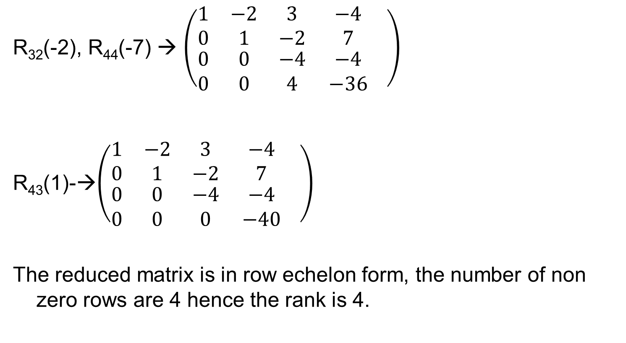
Cont..
R₃₂(-2), R₄₄(-7) → $\left(\begin{matrix}1 & −2 & 3 \\ 0 & 1 & −2 \\ \begin{aligned}0 \\ 0\end{aligned} & \begin{aligned}0 \\ 0\end{aligned} & \begin{aligned}−4 \\ 4\end{aligned}\end{matrix} \begin{matrix}−4 \\ 7 \\ \begin{aligned}−4 \\ −36\end{aligned}\end{matrix} \right)$
R₄₃(1)-→$\left(\begin{matrix}1 & −2 & 3 \\ 0 & 1 & −2 \\ \begin{aligned}0 \\ 0\end{aligned} & \begin{aligned}0 \\ 0\end{aligned} & \begin{aligned}−4 \\ 0\end{aligned}\end{matrix} \begin{matrix}−4 \\ 7 \\ \begin{aligned}−4 \\ −40\end{aligned}\end{matrix} \right)$
The reduced matrix is in row echelon form, the number of non zero rows are 4 hence the rank is 4.

Slide 13
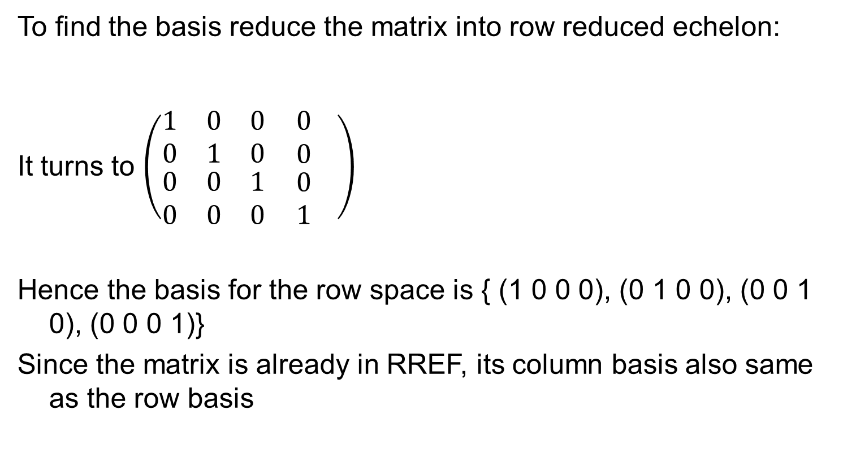
Problem
To find the basis reduce the matrix into row reduced echelon:
It turns to $\left(\begin{matrix}1 & 0 & 0 \\ 0 & 1 & 0 \\ \begin{aligned}0 \\ 0\end{aligned} & \begin{aligned}0 \\ 0\end{aligned} & \begin{aligned}1 \\ 0\end{aligned}\end{matrix} \begin{matrix}0 \\ 0 \\ \begin{aligned}0 \\ 1\end{aligned}\end{matrix} \right)$
Hence the basis for the row space is { (1 0 0 0), (0 1 0 0), (0 0 1 0), (0 0 0 1)}
Since the matrix is already in RREF, its column basis also same as the row basis

Slide 14
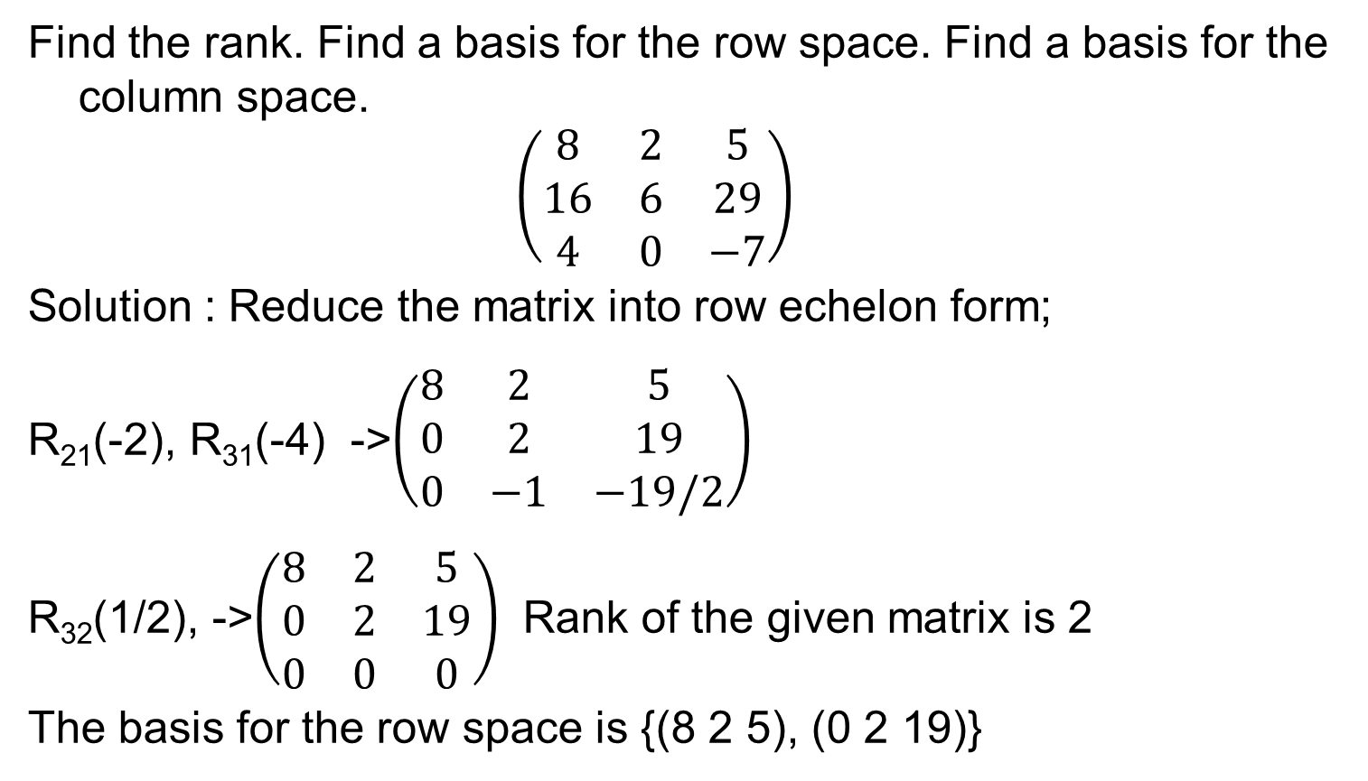
Problem
Find the rank. Find a basis for the row space. Find a basis for the column space.
$$\left(\begin{matrix}8 & 2 & 5 \\ 16 & 6 & 29 \\ 4 & 0 & −7\end{matrix}\right)$$
Solution : Reduce the matrix into row echelon form;
R₂₁(-2), R₃₁(-4) ->$\left(\begin{matrix}8 & 2 & 5 \\ 0 & 2 & 19 \\ 0 & −1 & −19/2\end{matrix}\right)$
R₃₂(1/2), ->$\left(\begin{matrix}8 & 2 & 5 \\ 0 & 2 & 19 \\ 0 & 0 & 0\end{matrix}\right)$ Rank of the given matrix is 2
The basis for the row space is {(8 2 5), (0 2 19)}

Slide 15
Cont..
Because we have only performed linear operations on rows, the non-zero rows in the reduced row echelon form of the matrix comprise a Basis for the Row Space of the matrix. (Note that this is not true of the Column Space; the Column Space certainly changes as you perform row operations.)

Slide 16
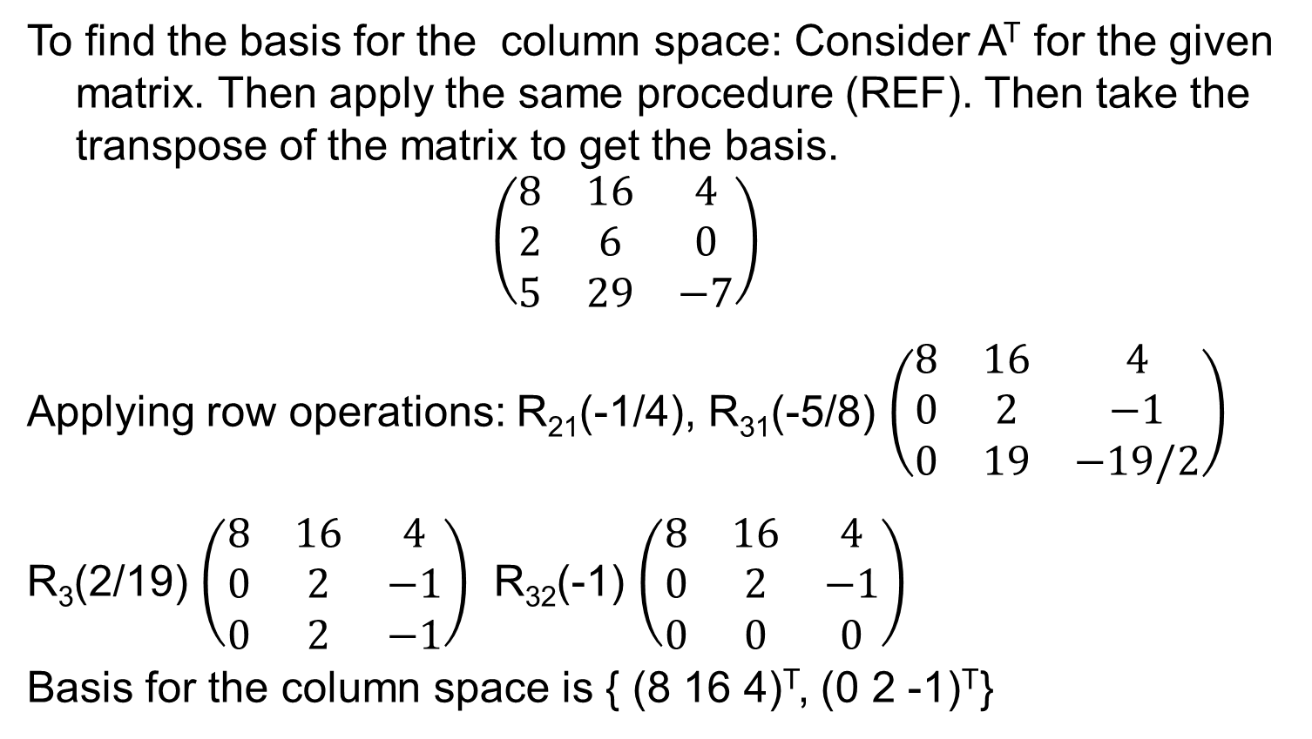
Problem
To find the basis for the column space: Consider A^{T} for the given matrix. Then apply the same procedure (REF). Then take the transpose of the matrix to get the basis.
$$\left(\begin{matrix}8 & 16 & 4 \\ 2 & 6 & 0 \\ 5 & 29 & −7\end{matrix}\right)$$
Applying row operations: R₂₁(-1/4), R₃₁(-5/8) $\left(\begin{matrix}8 & 16 & 4 \\ 0 & 2 & −1 \\ 0 & 19 & −19/2\end{matrix}\right)$
R₃(2/19) $\left(\begin{matrix}8 & 16 & 4 \\ 0 & 2 & −1 \\ 0 & 2 & −1\end{matrix}\right)$ R₃₂(-1) $\left(\begin{matrix}8 & 16 & 4 \\ 0 & 2 & −1 \\ 0 & 0 & 0\end{matrix}\right)$
Basis for the column space is { (8 16 4)^{T}, (0 2 -1)^{T}}

Slide 17
Todays Lecture
Linear transformations
Linear transformation.
Rank and Nullity

Slide 18
Definiton
Let X and Y be any vector spaces.
To each vector x in X we assign a unique vector y in Y. Then we say that a mapping (or transformation or operator) of X into Y is given.
Such a mapping is denoted by a capital letter, say F.
The vector y in Y assigned to a vector x in X is called the image of x under F and is denoted by F (x)

Slide 19
Linear Transformation
F is called a linear mapping or linear transformation if, for all vectors v and x in X and scalars c,
F (v + x) = F (v) + F (x)
F(cx)= cF(x)
Null Space and Nullity are concepts in linear algebra which are used to identify the linear relationship among attributes.

Slide 20
For a given matrix A the solution set of the homogeneous system (Ax= 0) is a vector space, called the null space of A, and its dimension is called the nullity of A.
Nullity of A: the number of linearly independent vectors in the null space.
Rank A: For a given matrix A, the maximum number of linearly independent row vectors of A. It is denoted by rank A.

Slide 21
Rank - Nullity theorem
For any m × n matrix A,
rank A + nullity A= n ( Number of columns of A).

Slide 22
Linear Transformation of Space R^{n} into R^{m} Space
Let X= R^{n} and Y=R^{m}. Then any real mXn matrix A= [aij]
gives a transformation of into R^{n} into R^{m},
Y=AX
Since A(u + x) = Au + Ax and A(cx) = cAx, this transformation is linear.
Every linear transformation F of R^{n} into R^{m} can be given
in terms of an mXn matrix A, after a basis for R^{n} and a basis for R^{m} have been chosen.

Slide 25
Example
For a matrix A find a basis for the nullspace and verify rank- nullity theorem.
Solution: To get the basis for the nullspace we have to consider the homogeneous system Ax=0, then create the augmented matrix, then apply row transformation to get into row echelon form then we have the following matrix.

Slide 26
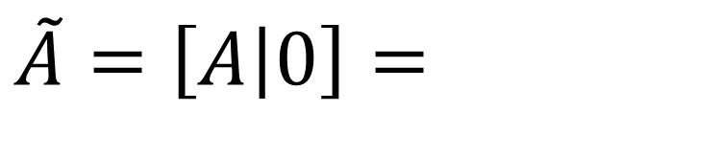
Cont..
$\tilde{A}=\left[A | 0\right]=$

Slide 27
Cont…

Slide 28
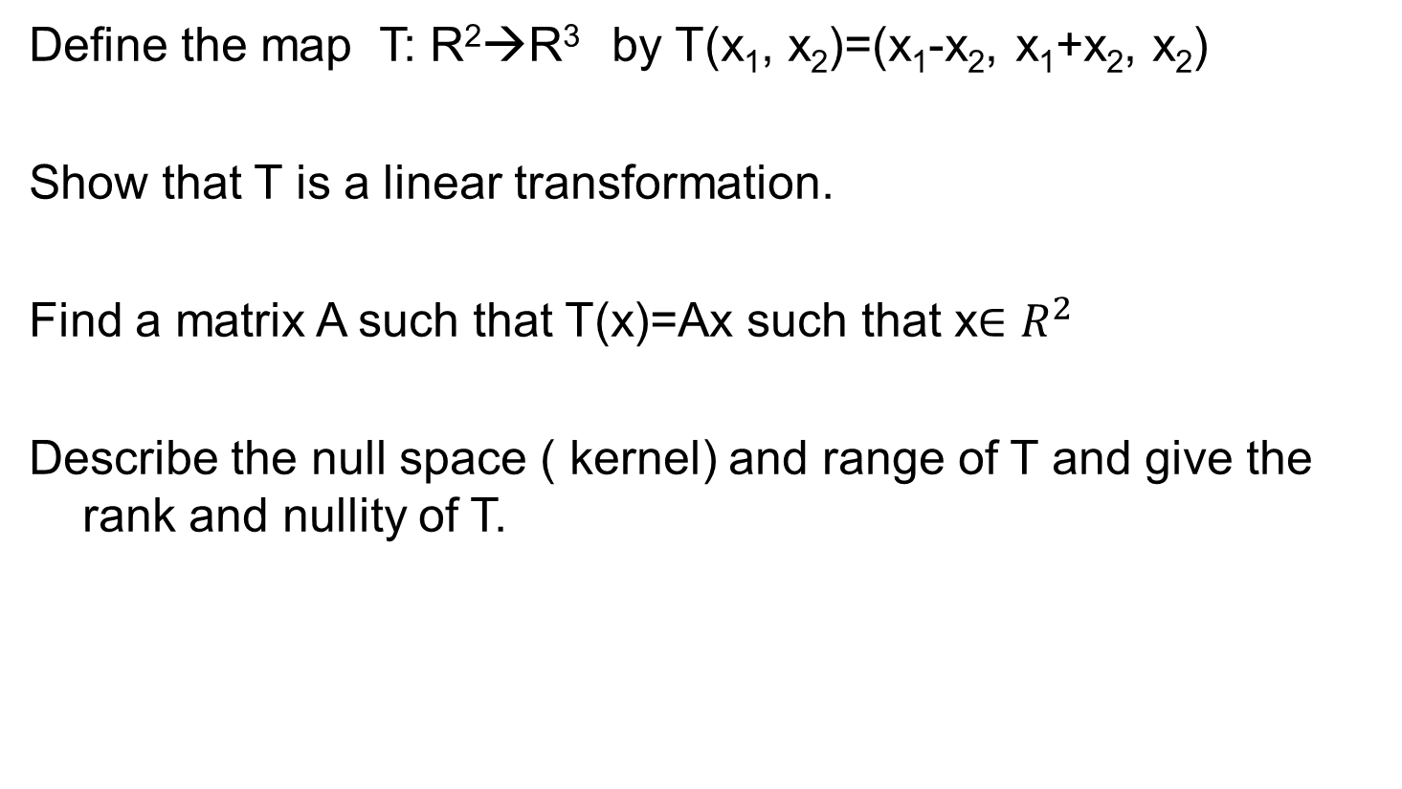
Define the map T: R²→R³ by T(x₁, x₂)=(x₁-x₂, x₁+x₂, x₂)
Show that T is a linear transformation.
Find a matrix A such that T(x)=Ax such that x$∈R^{2}$
Describe the null space ( kernel) and range of T and give the rank and nullity of T.

Slide 29
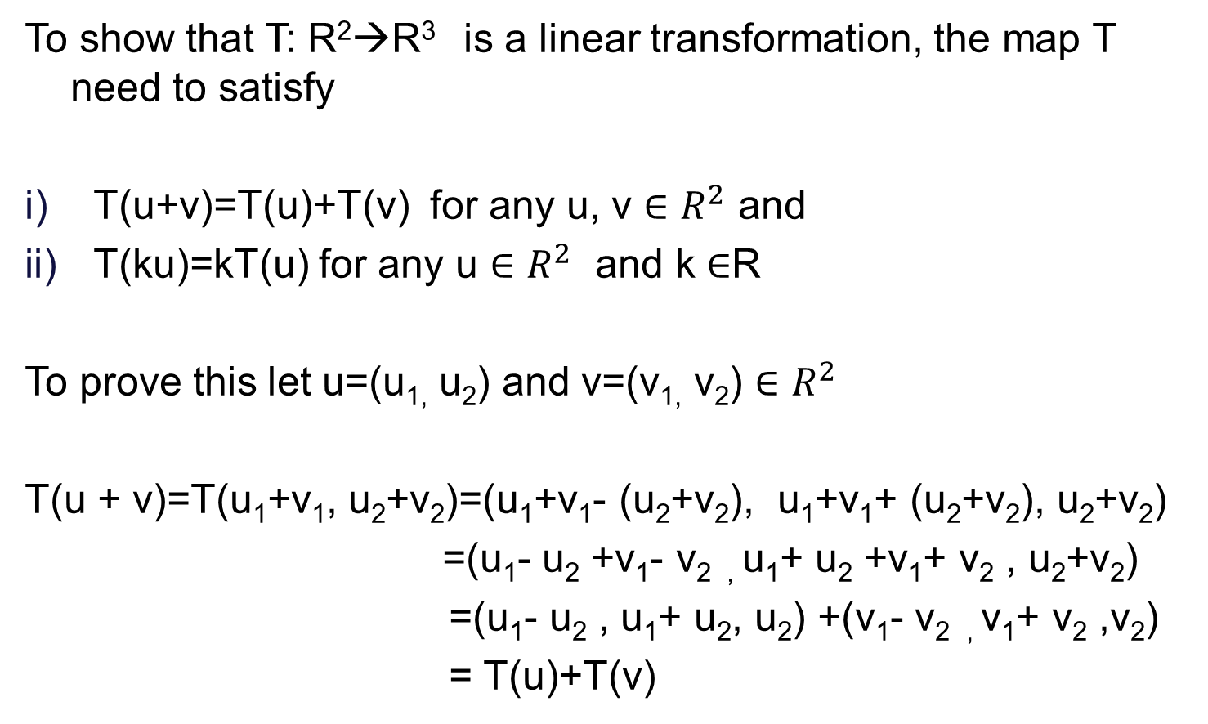
To show that T: R²→R³ is a linear transformation, the map T need to satisfy
T(u+v)=T(u)+T(v) for any u, v $∈R^{2}$ and
T(ku)=kT(u) for any u $∈R^{2}$ and k $∈$R
To prove this let u=(u_{1,} u₂) and v=(v_{1,} v₂) $∈R^{2}$
T(u + v)=T(u₁+v₁, u₂+v₂)=(u₁+v₁- (u₂+v₂), u₁+v₁+ (u₂+v₂), u₂+v₂)
=(u₁- u₂ +v₁- v_{2 ,} u₁+ u₂ +v₁+ v₂ , u₂+v₂)
=(u₁- u₂ , u₁+ u₂, u₂) +(v₁- v_{2 ,} v₁+ v₂ ,v₂)
= T(u)+T(v)

Slide 30

For any u=(u_{1,} u₂) $∈R^{2}$ and c $∈$R,
T(c u)= T(cu_{1,} cu₂)=(cu₁-cu_{2 ,} cu₁+cu₂, cu₂)= c (u₁- u₂ , u₁+ u₂, u₂)
=cT(u)
Thus T is a linear transformation from R²→R^{3 .}

Slide 31
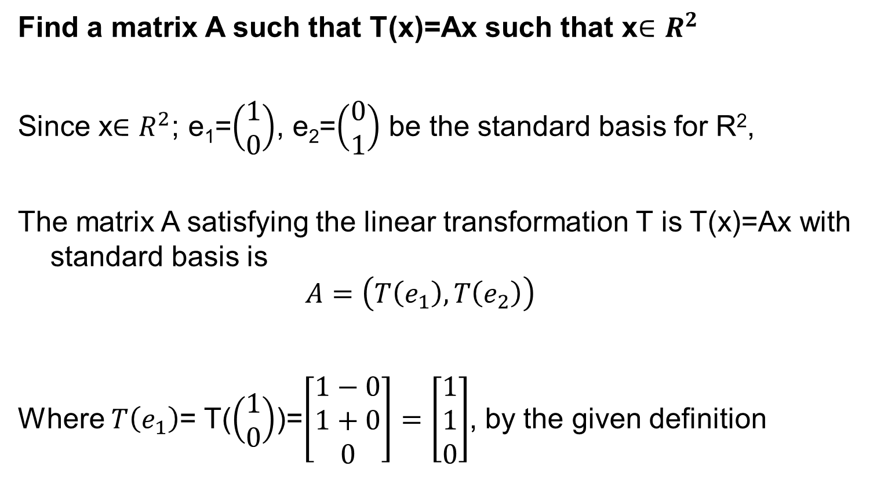
Find a matrix A such that T(x)=Ax such that x$∈R^{2}$
Since x$∈R^{2}$; e₁=$\left(\begin{matrix}1 \\ 0\end{matrix}\right)$, e₂=$\left(\begin{matrix}0 \\ 1\end{matrix}\right)$ be the standard basis for R²,
The matrix A satisfying the linear transformation T is T(x)=Ax with standard basis is
$$A=\left(T\left(e_{1}\right),T\left(e_{2}\right)\right)$$
Where $T\left(e_{1}\right)$= T($\left(\begin{matrix}1 \\ 0\end{matrix}\right)$)=$\left[\begin{matrix}1−0 \\ 1+0 \\ 0\end{matrix}\right]=\left[\begin{matrix}1 \\ 1 \\ 0\end{matrix}\right]$, by the given definition

Slide 32

$T\left(e_{2}\right)$= T($\left(\begin{matrix}0 \\ 1\end{matrix}\right)$)=$\left[\begin{matrix}0−1 \\ 0+1 \\ 1\end{matrix}\right]=\left[\begin{matrix}−1 \\ 1 \\ 1\end{matrix}\right]$
then A is
$$A=\left[\begin{matrix}1 & −1 \\ 1 & 1 \\ 0 & 1\end{matrix}\right]$$

Slide 33
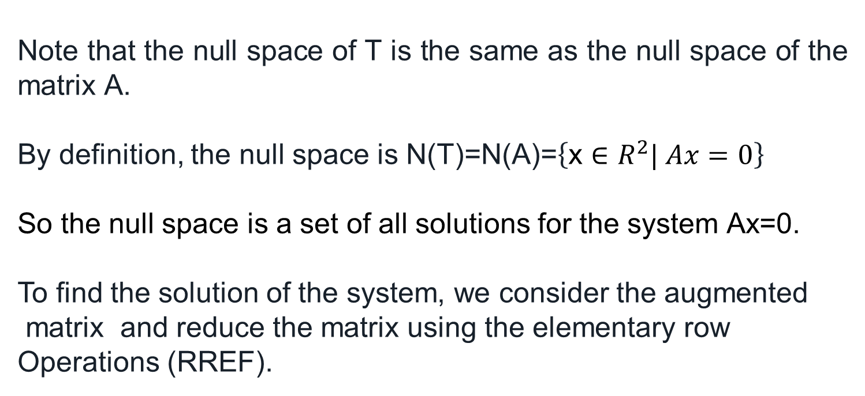
Null Space and Nullity
Note that the null space of T is the same as the null space of the matrix A.
By definition, the null space is N(T)=N(A)=$\left\{\text{x}∈R^{2}| Ax=0\right\}$
So the null space is a set of all solutions for the system Ax=0.
To find the solution of the system, we consider the augmented
matrix and reduce the matrix using the elementary row
Operations (RREF).

Slide 34
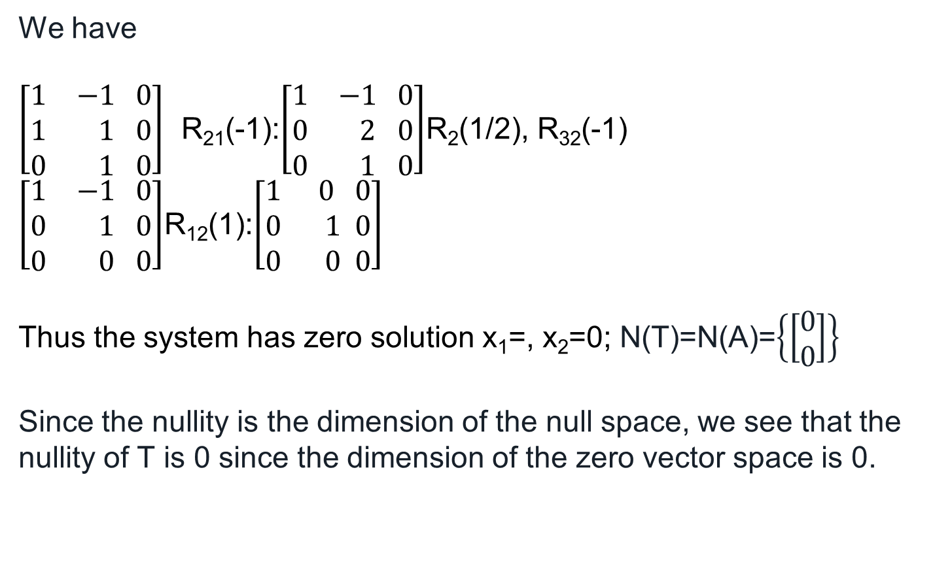
Null space
We have
$\left[\begin{matrix}1 & −1 \\ 1 & 1 \\ 0 & 1\end{matrix}\begin{matrix}0 \\ 0 \\ 0\end{matrix}\right]$ R₂₁(-1):$\left[\begin{matrix}1 & −1 \\ 0 & 2 \\ 0 & 1\end{matrix}\begin{matrix}0 \\ 0 \\ 0\end{matrix}\right]$R₂(1/2), R₃₂(-1) $\left[\begin{matrix}1 & −1 \\ 0 & 1 \\ 0 & 0\end{matrix}\begin{matrix}0 \\ 0 \\ 0\end{matrix}\right]$R₁₂(1):$\left[\begin{matrix}1 & 0 \\ 0 & 1 \\ 0 & 0\end{matrix}\begin{matrix}0 \\ 0 \\ 0\end{matrix}\right]$
Thus the system has zero solution x₁=, x₂=0; N(T)=N(A)=$\left\{\left[\begin{matrix}0 \\ 0\end{matrix}\right]\right\}$
Since the nullity is the dimension of the null space, we see that the nullity of T is 0 since the dimension of the zero vector space is 0.

Slide 35
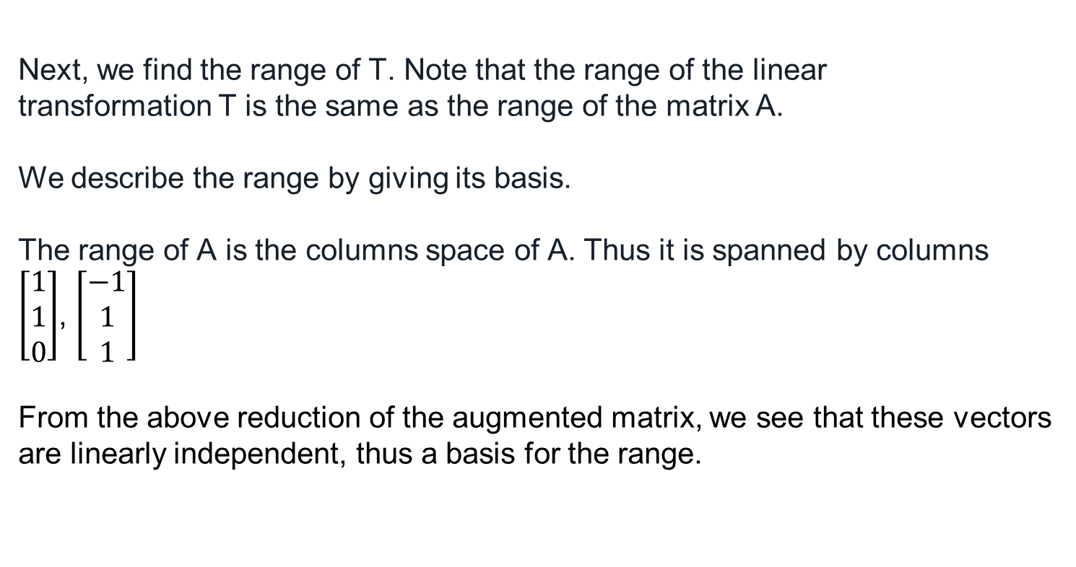
Range:
Next, we find the range of T. Note that the range of the linear transformation T is the same as the range of the matrix A.
We describe the range by giving its basis.
The range of A is the columns space of A. Thus it is spanned by columns
$\left[\begin{matrix}1 \\ 1 \\ 0\end{matrix}\right]$, $\left[\begin{matrix}−1 \\ 1 \\ 1\end{matrix}\right]$
From the above reduction of the augmented matrix, we see that these vectors are linearly independent, thus a basis for the range.

Slide 36
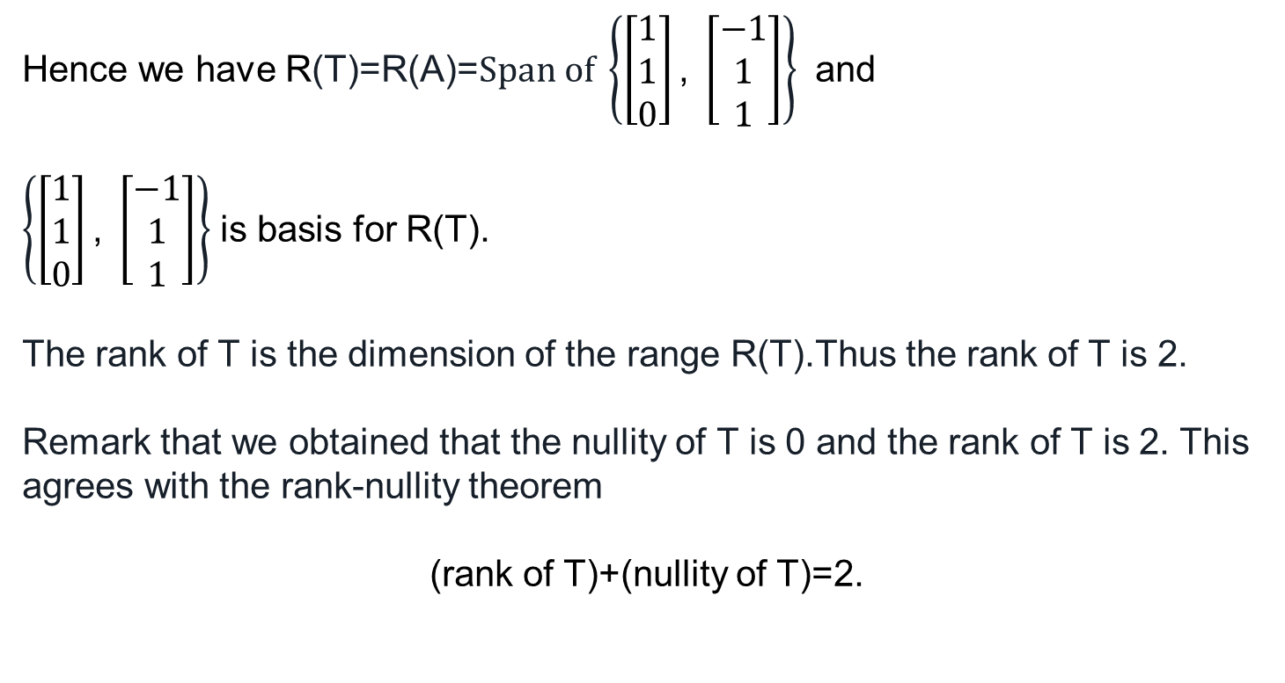
Rank of T
Hence we have R(T)=R(A)=$Span of \left\{\left[\begin{matrix}1 \\ 1 \\ 0\end{matrix}\right]\text{,} \left[\begin{matrix}−1 \\ 1 \\ 1\end{matrix}\right]\right\}$ and
$\left\{\left[\begin{matrix}1 \\ 1 \\ 0\end{matrix}\right]\text{,} \left[\begin{matrix}−1 \\ 1 \\ 1\end{matrix}\right]\right\}$ is basis for R(T).
The rank of T is the dimension of the range R(T).Thus the rank of T is 2.
Remark that we obtained that the nullity of T is 0 and the rank of T is 2. This agrees with the rank-nullity theorem
(rank of T)+(nullity of T)=2.

Slide 37
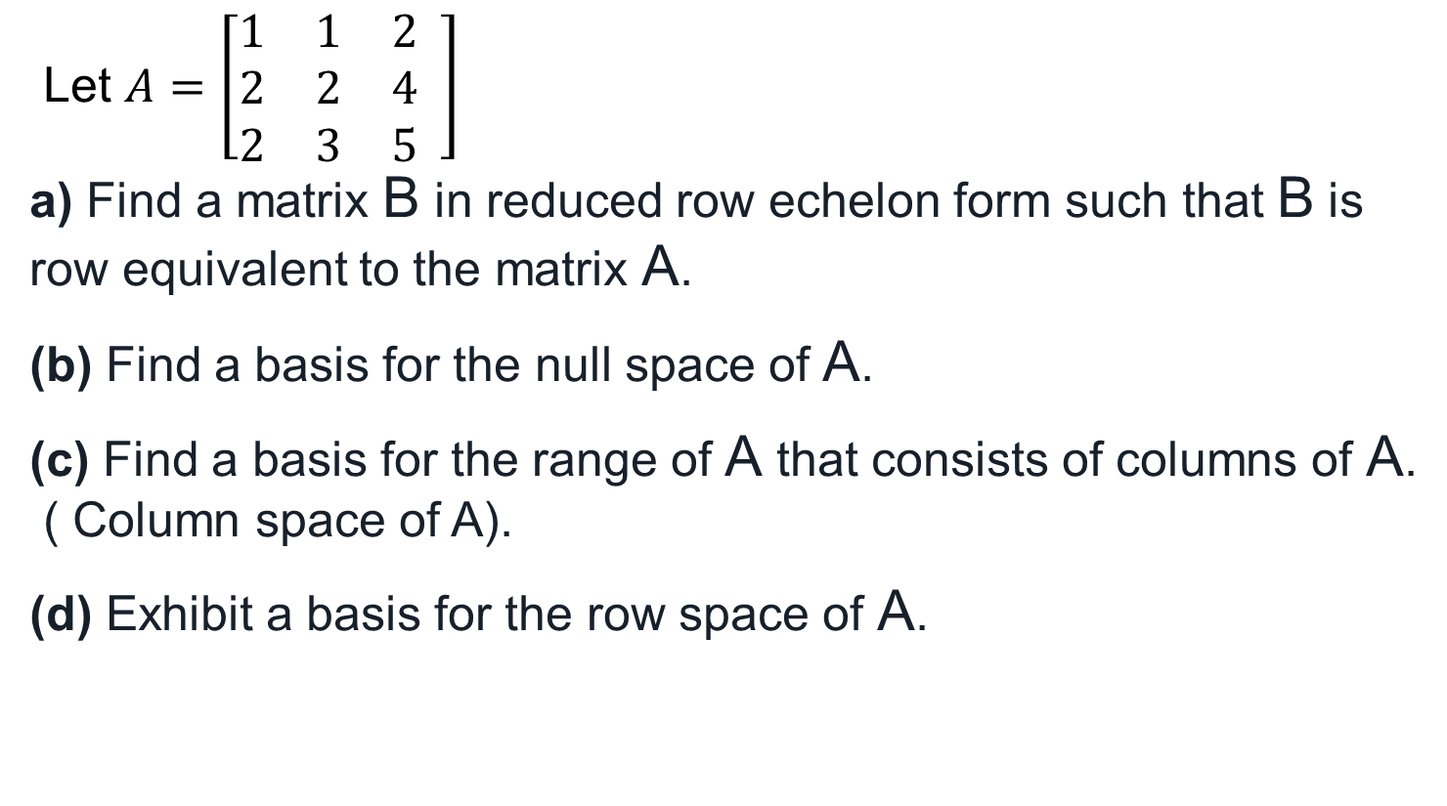
Find a Basis of the Range, Rank, and Nullity of a Matrix
Let $A=\left[\begin{matrix}1 & 1 & 2 \\ 2 & 2 & 4 \\ 2 & 3 & 5\end{matrix} \right]$
a) Find a matrix B in reduced row echelon form such that B is row equivalent to the matrix A.
(b) Find a basis for the null space of A.
(c) Find a basis for the range of A that consists of columns of A.
( Column space of A).
(d) Exhibit a basis for the row space of A.

Slide 38
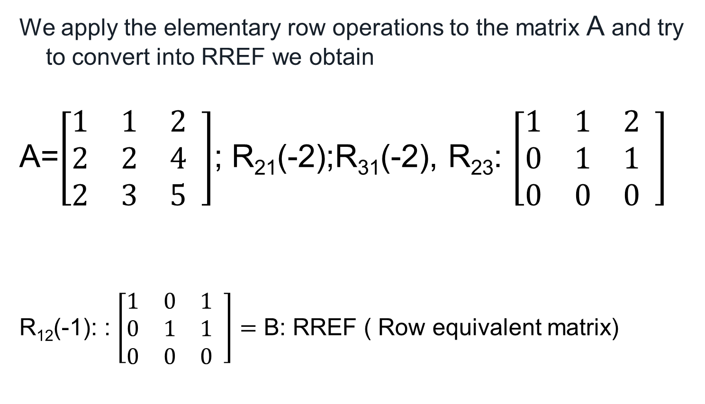
Row equivallent
We apply the elementary row operations to the matrix A and try to convert into RREF we obtain
A=$\left[\begin{matrix}1 & 1 & 2 \\ 2 & 2 & 4 \\ 2 & 3 & 5\end{matrix} \right]$; R₂₁(-2);R₃₁(-2), R₂₃: $\left[\begin{matrix}1 & 1 & 2 \\ 0 & 1 & 1 \\ 0 & 0 & 0\end{matrix} \right]$
R₁₂(-1): : $\left[\begin{matrix}1 & 0 & 1 \\ 0 & 1 & 1 \\ 0 & 0 & 0\end{matrix} \right]=$ B: RREF ( Row equivalent matrix)

Slide 39
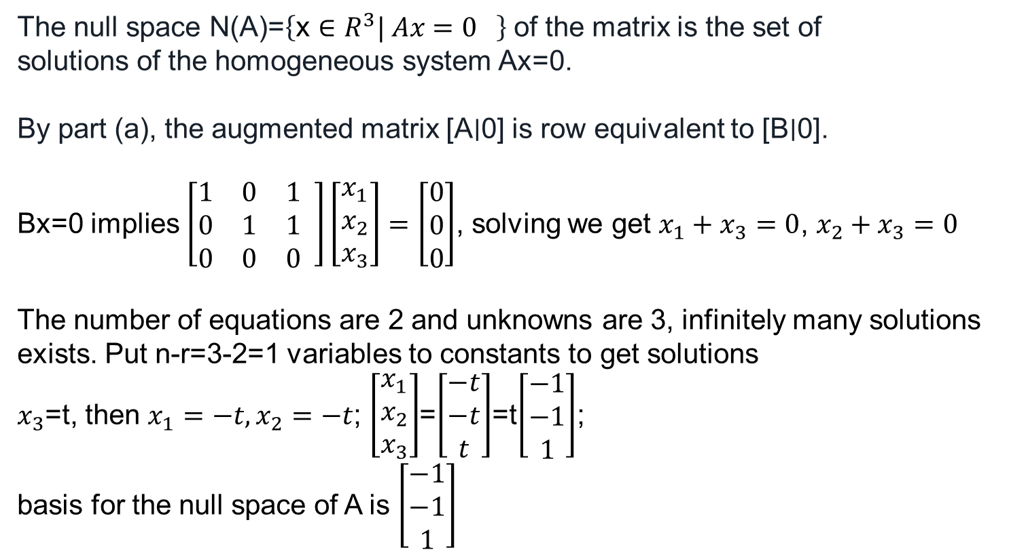
basis for the null space of A
The null space N(A)=$\left\{\text{x}∈R^{3}| Ax=0 \right\}$ of the matrix is the set of
solutions of the homogeneous system Ax=0.
By part (a), the augmented matrix [A∣0] is row equivalent to [B∣0].
Bx=0 implies $\left[\begin{matrix}1 & 0 & 1 \\ 0 & 1 & 1 \\ 0 & 0 & 0\end{matrix} \right]\left[\begin{matrix}x_{1} \\ x_{2} \\ x_{3}\end{matrix}\right]=\left[\begin{matrix}0 \\ 0 \\ 0\end{matrix}\right]$, solving we get $x_{1}+x_{3}=0$, $x_{2}+x_{3}=0$
The number of equations are 2 and unknowns are 3, infinitely many solutions exists. Put n-r=3-2=1 variables to constants to get solutions
$x_{3}$=t, then $x_{1}=−t,x_{2}=−t$; $\left[\begin{matrix}x_{1} \\ x_{2} \\ x_{3}\end{matrix}\right]$=$\left[\begin{matrix}−t \\ −t \\ t\end{matrix}\right]$=t$\left[\begin{matrix}−1 \\ −1 \\ 1\end{matrix}\right]$;
basis for the null space of A is $\left[\begin{matrix}−1 \\ −1 \\ 1\end{matrix}\right]$

Slide 40

a basis for the row space of A.
We already reduced the matrix in row echelon form
$$\left[\begin{matrix}1 & 0 & 1 \\ 0 & 1 & 1 \\ 0 & 0 & 0\end{matrix} \right]$$
The basis for the row space is {(1 0 1), (0 1 1)}.

Slide 41
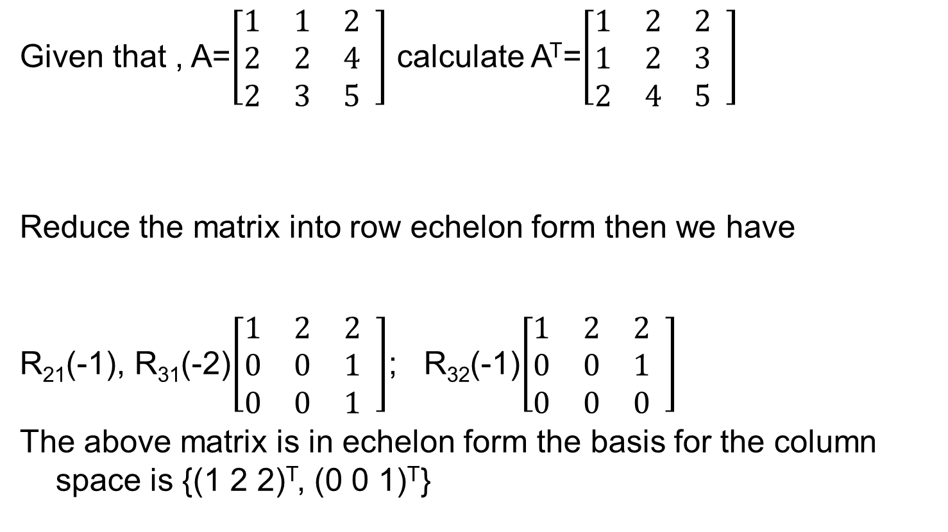
A basis for the column space of A.
Given that , A=$\left[\begin{matrix}1 & 1 & 2 \\ 2 & 2 & 4 \\ 2 & 3 & 5\end{matrix} \right]$ calculate A^{T}=$\left[\begin{matrix}1 & 2 & 2 \\ 1 & 2 & 3 \\ 2 & 4 & 5\end{matrix} \right]$
Reduce the matrix into row echelon form then we have
R₂₁(-1), R₃₁(-2)$\left[\begin{matrix}1 & 2 & 2 \\ 0 & 0 & 1 \\ 0 & 0 & 1\end{matrix} \right]$; R₃₂(-1)$\left[\begin{matrix}1 & 2 & 2 \\ 0 & 0 & 1 \\ 0 & 0 & 0\end{matrix} \right]$
The above matrix is in echelon form the basis for the column space is {(1 2 2)^{T}, (0 0 1)^{T}}

